Slide 1
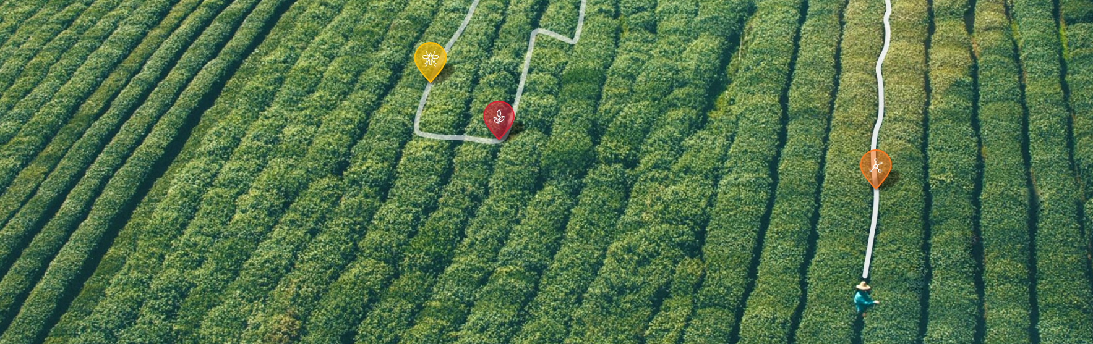

Developer Home Task
December 2016

Slide 2

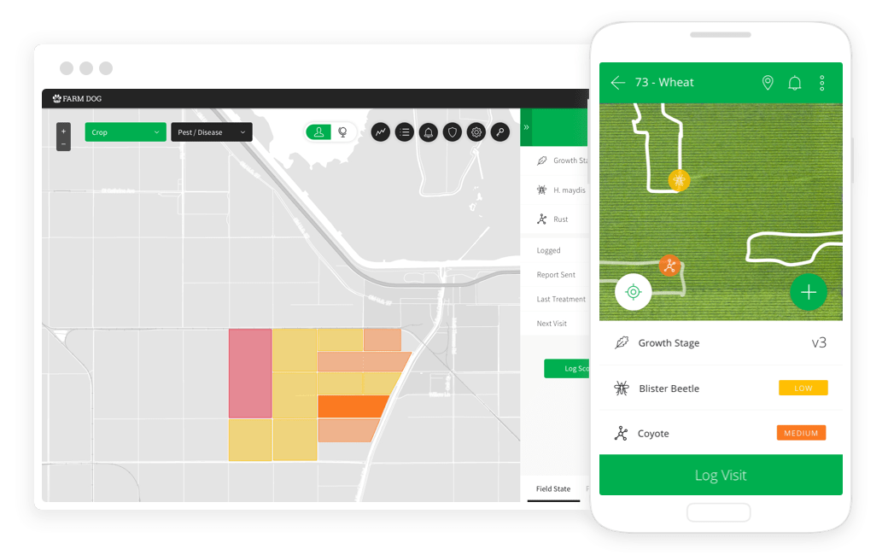
Brief Overview
Farm Dog Scout is a precision agriculture solution for field scouting and integrated pest management (IPM)
The solution includes:
a scouting app, for folks scouting the field
a web-based dashboard for data analysis
It’s key features are:
scout management
data logging
reporting
pest and disease prediction

Slide 3
Task
This task will assess your coding skills.
In the following slide you will find a mockup which you need to build.
Build it with Angular1 or Angular2 or React (whichever you’re most comfortable with)
The page has a panel, which needs to slide open from the left when the Open Panel button is pressed. The panel slides closed if the X is clicked.
The panel lists countries and their capitals, that are in the continent selected in the dropdown. You can find a country API here https://restcountries.eu/.
Per capital, pull the current weather state, which you can pull from here https://openweathermap.org/api (weather description)
A user can search the list for country, capital or weather. The list needs to instantly filter according to the user’s input (key by key). Sort the list by country name.
Make the default continent is America. If a user changes the continent, closes the panel and reopens it, the panel should stay on the user’s last selection.
BONUS: Add a hover effect of your choice to the buttons on the page, and highlight country row on mouse hover.
You may use external plugins.

Slide 4
OPEN PANEL
Weather in country capitals
X
America
Search country, city or weather
United states Washington, D.C. Rain
Mexico Mexico City Sunny
Brazil Brasília Sunny

Slide 5
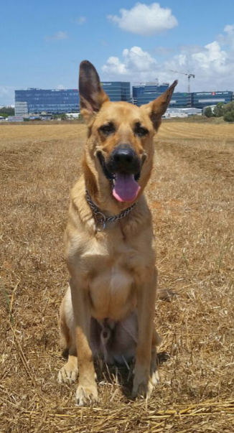
Good luck!
(Woof)

